Slide 1

HR Analytics
Employee Retention
SQL Queries

Slide 2
CONTENTS
Dataset Name: HR_1 & HR_2
Dataset Type: Excel Data
Dataset Size: 50k records each

Slide 3
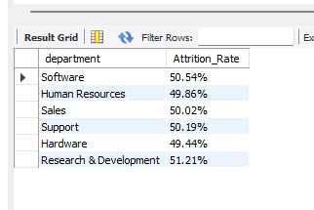
1. Average Attrition rate for all Departments
SQL Query
select a.department, concat(format(avg(a.attrition_y)*100,2),'%') as Attrition_Rate
from ( select department,attrition,
case when attrition='Yes'
then 1
Else 0
End as attrition_y from hr_1 ) as a
group by a.department;
Result

Slide 4
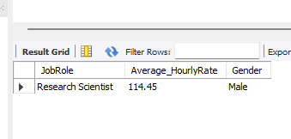
2. Average Hourly rate of Male Research Scientist
SQL Query
select JobRole, format(avg(hourlyrate),2) as Average_HourlyRate,Gender
from hr_1
where upper(jobrole)= 'RESEARCH SCIENTIST' and upper(gender)='MALE'
group by jobrole,gender;
Result

Slide 5
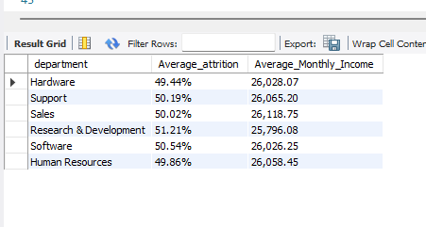
3.Attrition rate Vs Monthly income stats
SQL Query
alter table hr_2 change column `Employee ID` EmployeeId varchar(255) NOT NULL;
select a.department, concat(format(avg(a.attrition_rate)*100,2),'%') as Average_attrition,format(avg(b.monthlyincome),2) as Average_Monthly_Income
from ( select department,attrition,employeenumber,
case when attrition = 'yes' then 1
else 0
end as attrition_rate from hr_1) as a
inner join hr_2 as b on b.EmployeeId = a.employeenumber
group by a.department;
Result

Slide 6
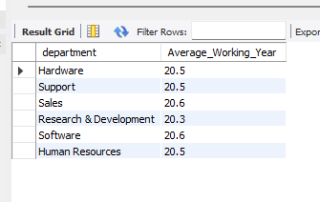
4. Average working years for each Department
SQL Query
select a.department, format(avg(b.TotalWorkingYears),1) as Average_Working_Year
from hr_1 as a
inner join hr_2 as b on b.EmployeeId=a.EmployeeNumber
group by a.department;
Result

Slide 7
5. Job Role Vs Work life balance
SQL Query
select a.JobRole,
sum(case when performancerating = 1 then 1 else 0 end) as Total_PerformanceRating1,
sum(case when performancerating = 2 then 1 else 0 end) as Total_PerformanceRating2,
sum(case when performancerating = 3 then 1 else 0 end) as Total_PerformanceRating3,
sum(case when performancerating = 4 then 1 else 0 end) as Total_PerformanceRating4,
count(b.performancerating) as Total_Employee, format(avg(b.WorkLifeBalance),2) as Average_WorkLifeBalance_Rating
from hr_1 as a
inner join hr_2 as b on b.EmployeeID = a.Employeenumber
group by a.jobrole;

Slide 8
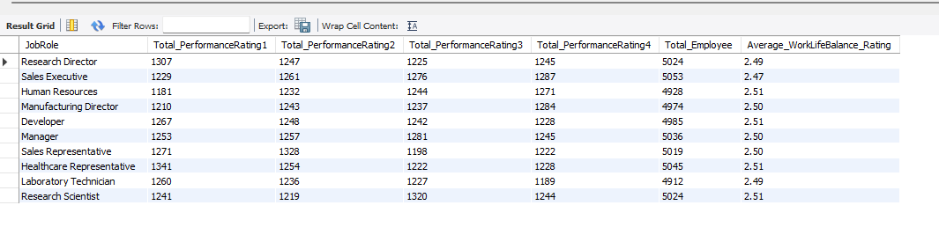
Result

Slide 9
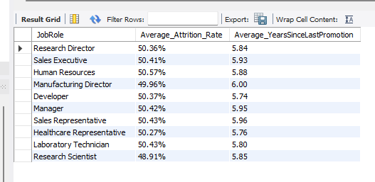
6. Attrition rate Vs Year since last promotion relation
SQL Query
select a.JobRole,concat(format(avg(a.attrition_rate)*100,2),'%') as Average_Attrition_Rate,
format(avg(b.YearsSinceLastPromotion),2) as Average_YearsSinceLastPromotion
from ( select JobRole,attrition,employeenumber,
case when attrition = 'yes' then 1
else 0
end as attrition_rate from hr_1) as a
inner join hr_2 as b on b.employeeid = a.employeenumber
group by a.JobRole;
Result

